Slide 1

STOCK MARKET TRADING BOT
Team Members
19BAI1015 – UTTEJ KUMAR
19BAI1030 – KOUSHIK RACHAPUTI
19BAI1045 – JAYANTH POTTI

Slide 2

Problem Statement
This work implements a Real-time Stock Trading bot, trained using Deep Reinforcement Learning.

Slide 3

Abstract
We wanted to build a Stock Trading bot that works with real-time stock closing price data.
We attempted to compare the outcomes of the following agents: Policy Gradient Agent, Q-learning Agent, Moving Average Agent, and Actor Critic Agent.
We create an application that uses real-time stock data for automatic trading using the best model.

Slide 4
Introduction
Trading bots enable stock traders to automate the purchase, sale, and trading of stocks and other assets, as well as the execution of trades based on a specific trading strategy, with the goal of automating profits.
It is the process of using a set of rules or any mathematical model to generate profits at a high-speed frequency that a human trader would find impossible.
It is simply a method of reducing the cost, market impact, and risk associated with the execution of an order. Investment banks and hedge funds make extensive use of it.

Slide 5
Objective
To maximize profit while using the least amount of capital.
To forecast stock prices using price momentum and reinforcement learning.
To avoid significant price changes, trades will be instantaneous, resulting in lower transaction costs and brokerage fees.
Based on psychological facts, the possibility of human trader errors is reduced.

Slide 6

Methodology
Using the previously mentioned reinforcement agents, we begin training the model by taking the closing price as input, which influences in what action is necessary to receive the highest reward points for various agents.
For trading bots, state can be initially assumed of as historical/current prices, actions as buy/sell/hold, and rewards are whether the action results in profit/loss.

Slide 7
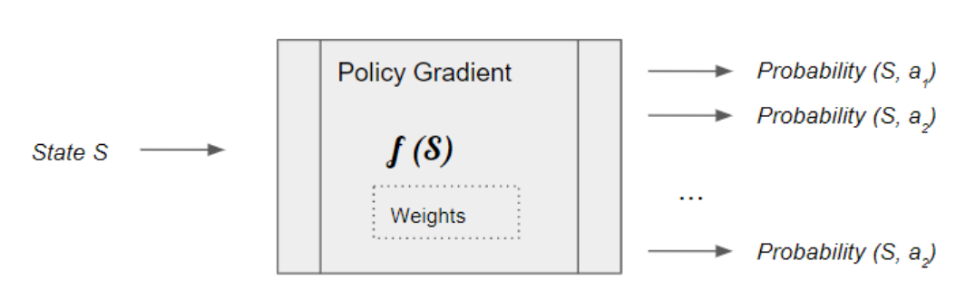
Models
Policy gradient:
Policy gradient methods are a type of reinforcement learning techniques that rely upon optimizing parametrized policies with respect to the expected return (long-term cumulative reward) by gradient descent.
The Policy Gradient learns its policy as it goes. At each step, it picks an action by sampling the predicted probability distribution. As a result it ends up taking a variety of different actions.

Slide 8
Q-Learning
Q-Learning algorithms learns by trying to find each state's action-value function — the Q-Value function. Its entire learning procedure is based on the idea of figuring out the quality of each possible action, and select according to this knowledge.
Initially, the agent randomly picks actions. But as the agent interacts with the environment, it learns which actions are better, based on rewards that it obtains. It uses this experience to incrementally update the Q values.
Q-learning aims to predict the reward of a certain action taken in a certain state, policy gradients directly predict the action itself.

Slide 9
Moving average
Moving averages are a simple and common type of smoothing used in time series analysis and time series forecasting. Calculating a moving average involves creating a new series where the values are comprised of the average of raw observations in the original time series

Slide 10
Actor Critic Agent
Actor Critic (A2C) algorithm combines two types of Reinforcement Learning algorithms (Policy Based and Value Based) together. Policy Based agents directly learn a policy (a probability distribution of actions) mapping input states to output actions.
In actor critic learning systems, exploration is fully determined by the action probabilities of the actor.

Slide 11
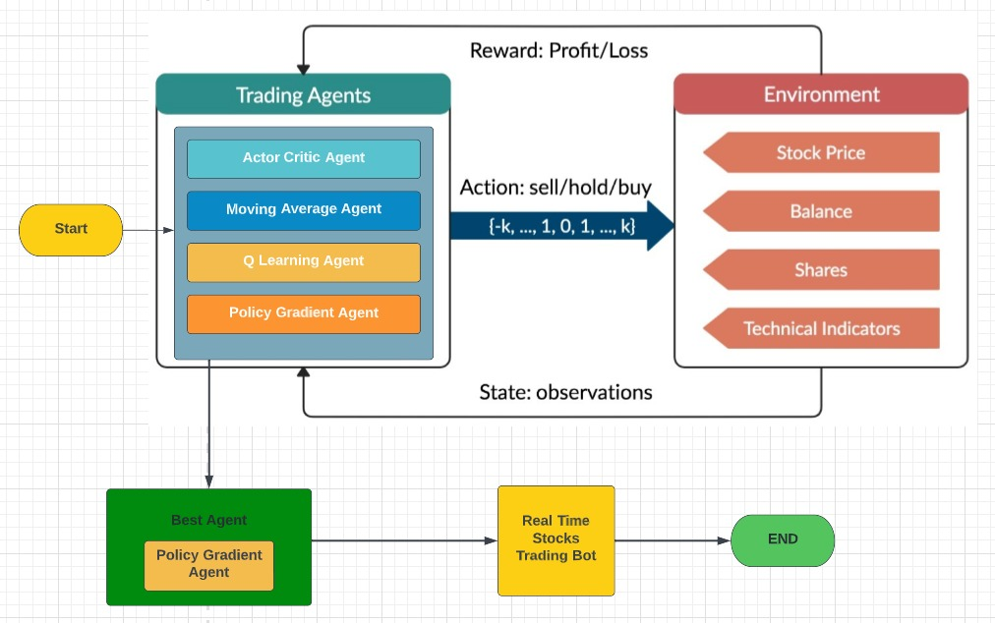
Architecture Diagram

Slide 12
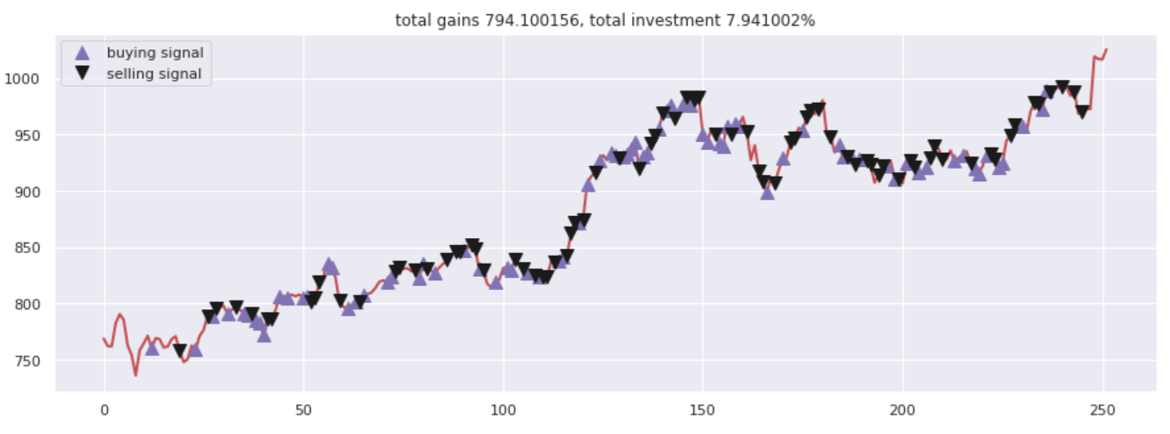
Results
Policy Gradient Agent:

Slide 13
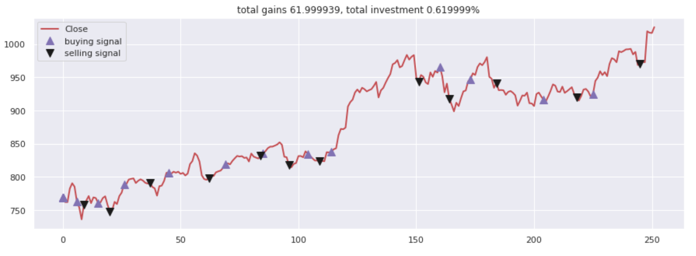
Moving Average Agent

Slide 14
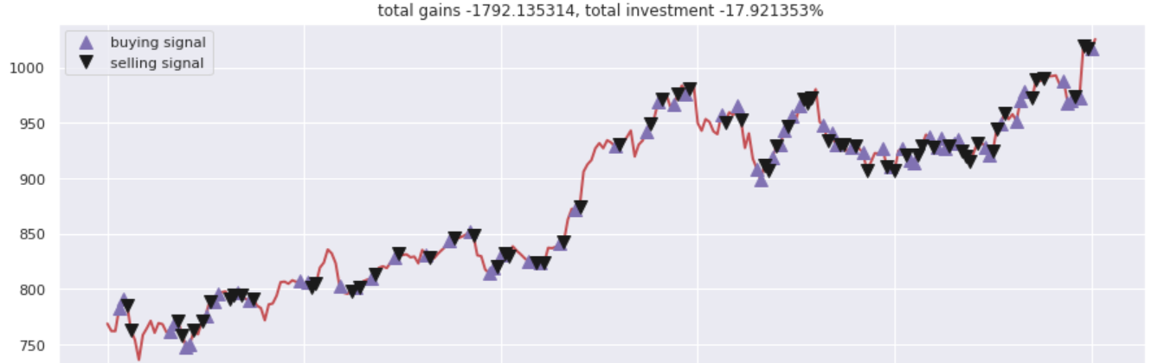
Actor Critic Agent

Slide 15
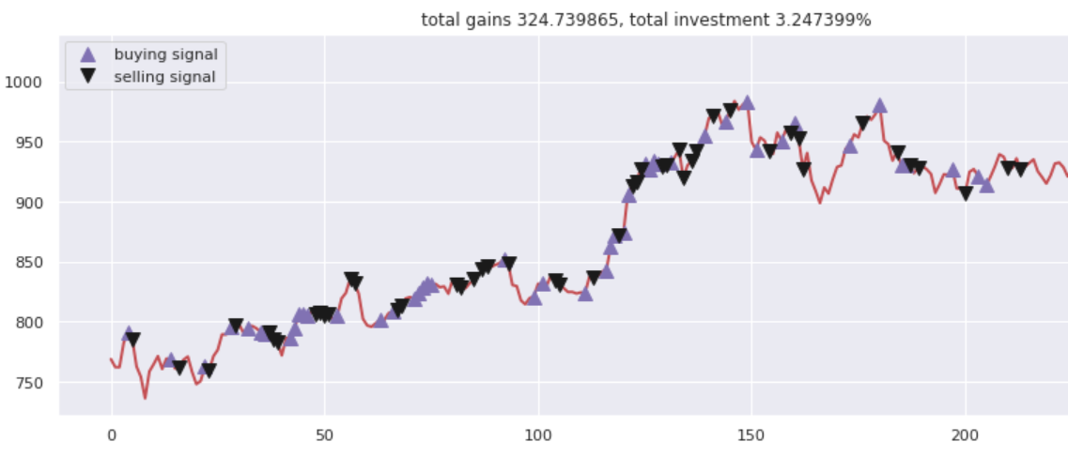
Q Learning

Slide 16

Result
By comparing the results of each agent, we can conclude that the Policy Gradient Agent is performing very well for our problem statement.
So, we take Policy Gradient Agent model for implementing Real time Stock Trading bot.

Slide 17
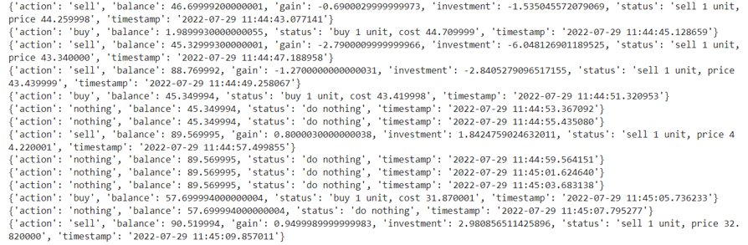
Final Results for Real Time Trading Bot

Slide 18
Conclusion
We have successfully created a Real time Stock Trading Bot using Policy Gradient Agent model which gives us the maximum reward points and profits by trading the initial starting amount assigned to the trading bot in least amount of time.

